Slide 1


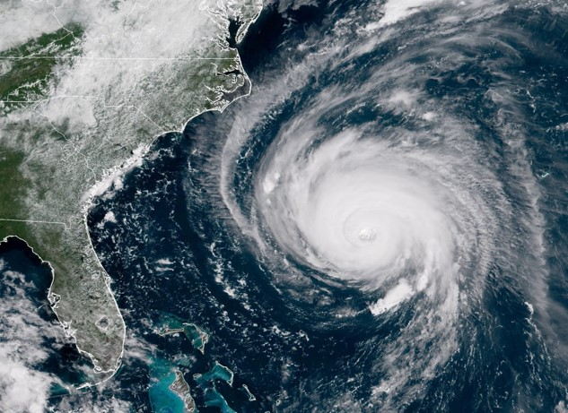
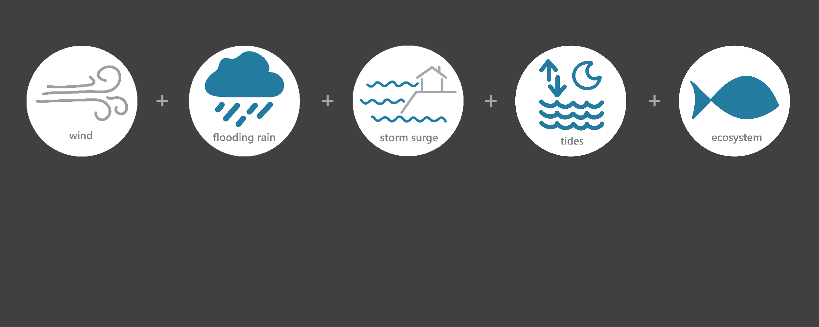

[ SEP 14 – SEP 18, 2018 ]
HURRICANE FLORENCE
1
Category
(Saffir-Simpson Scale)
3.3
Inches of Rain
66.2
Miles per hour
of Max Wind Speed
3-5
Feet of Storm Surge
(max)*
Image Credit: NOAA, taken on September 12, 2018
Monitoring the Impact of Hurricane Florence at “North Carolina NERR”
Hurricane Florence, a large and slow-moving Category 1 hurricane, made landfall along the southeastern coast of North Carolina. As Florence traveled inland across South Carolina, it weakened to a Tropical Storm. Torrential rain fell for days and caused historic flooding. The most devastating impacts were not from the initial wind, rain, and storm surge but from the extreme riverine flooding that lasted for several weeks following Florence’s landfall. The effects of Florence were observed at the North Carolina (NOC) NERR through the System-Wide Monitoring Program (SWMP), which tracks short-term variability and long-term change of weather and water quality in the areas surrounding Wilmington, South Port, and surrounding areas in New Hanover County in North Carolina.
Data shown are based on the NOC weather monitoring site
*Masonboro Sound
Created on February 8, 2022

Slide 2
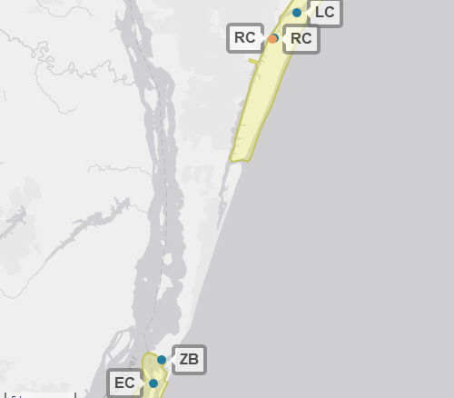
NOC
The North Carolina NERR (NOC) is one of 29 sites in the National Estuarine Research Reserve Systems (NERRS). Each site is a state-federal partnership that combines research, monitoring, and education to advance the understanding and management of estuarine environments.
North Carolina NERR
North Carolina Storm Monitoring
North Carolina NERR operates a weather station located at Research Creek (RC) and maintains four continuous, long-term water quality stations at Research Creek (RC), Loosin Creek (LC), Zeke’s Basin (ZB), and East Cribbing (EC). North Carolina NERR is part of the SWMP. As Hurricane Florence approached North Carolina, North Carolina NERR monitored the weather and water quality, collecting data every 15 minutes for the following parameters: air temperature, relative humidity, atmospheric pressure, rainfall, wind speed and direction, water temperature, depth, salinity, dissolved oxygen, turbidity, and pH.
Weather Station
Water Quality Sample Location

Slide 3
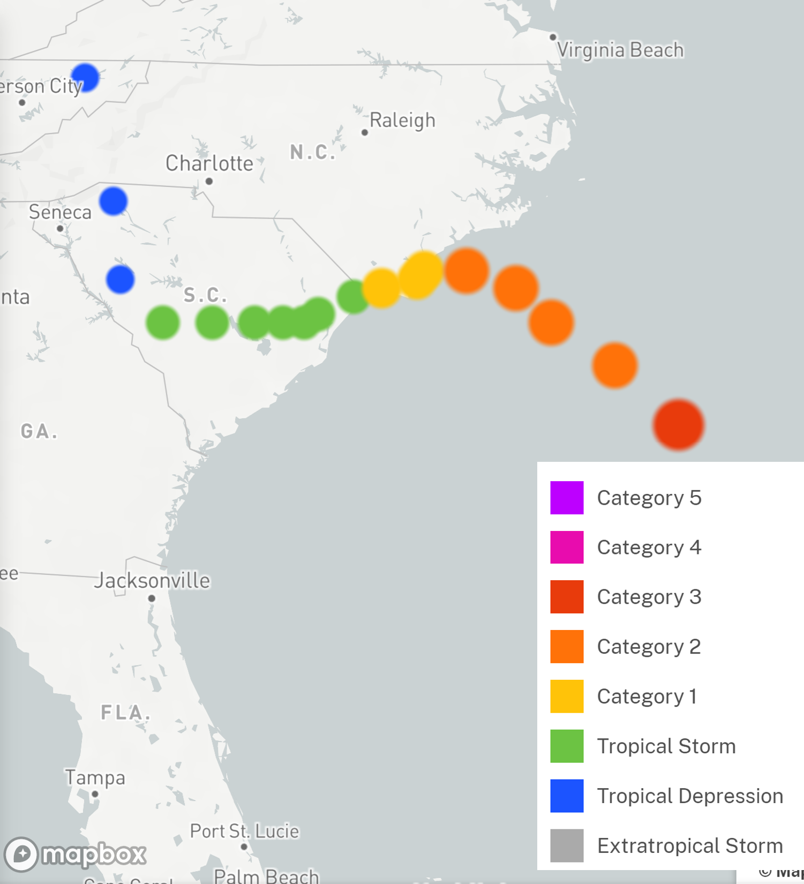
Florence made landfall near Wrightsville Beach, North Carolina on September 14. Florence stalled for an entire day before it began a slow turn to the southwest, traveling across South Carolina at a speed of 2-3 mph. The storm continued to weaken during September 15 and then traveled north-northeast out of the state on September 16.
There were 15 direct fatalities in North Carolina due to Florence - 11 from freshwater flooding involving motor vehicles and four from fallen trees from the wind. New Hanover County and Wilmington were isolated for several days as every access route (i.e., I-40 and U.S. Highways 17, 74, 76, and 421) were closed due to flooding. Over 22 million gallons of untreated sewage overflowed into area waterways.
Source: https://oceanservice.noaa.gov/news/historical-hurricanes/
North Carolina NERR
Damage and losses due to Florence’s impacts in North Carolina totaled $22 billion.
Florence was a Category 1 on the Saffir–Simpson scale when it made landfall along the southeastern coast of North Carolina.
Aquatic life, like oysters, crabs, shrimp, finfish, phytoplankton, etc. rely on specific levels of salinity and dissolved oxygen to thrive and survive. The freshwater flooding that resulted from Florence caused significant drops in the levels of salinity and dissolved oxygen for varying periods of time, potentially stressing organisms.
Station | Date | Rainfall Total (in) | Rainfall Average Intensity (in/hr) | Wind Speed Max (mph) | Wind Speed Average (mph)
Research Creek (RC) | 9/14/2018 | 3.64 | 0.139 | 66.2 | 38.2
Research Creek (RC) | 9/15/2018 | 0.38 | 0.016 | 56.4 | 37.1
Research Creek (RC) | 9/16/2018 | 0.15 | 0.006 | 45.2 | 28.3
Research Creek (RC) | 9/17/2018 | 0.09 | 0.004 | 28.9 | 16.6
Research Creek (RC) | 9/18/2018 | 0.05 | 0.002 | 18.1 | 13.2
The highest local rainfall and wind measurements were recorded when Florence made landfall in North Carolina near Wrightsville Beach.
Data reporting time periods for Hurricane Florence: 9/14/2018 - 9/18/2018

Slide 4
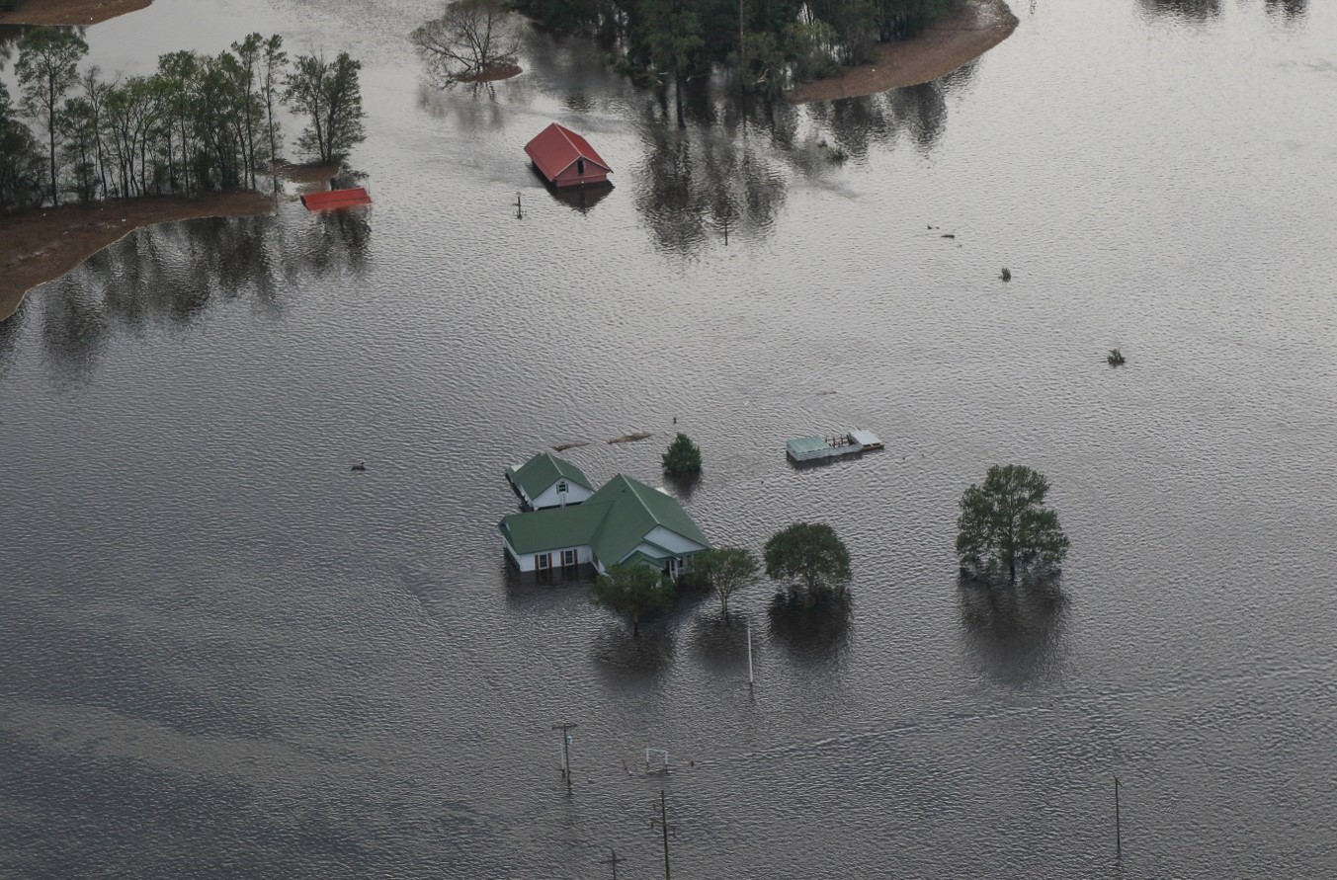
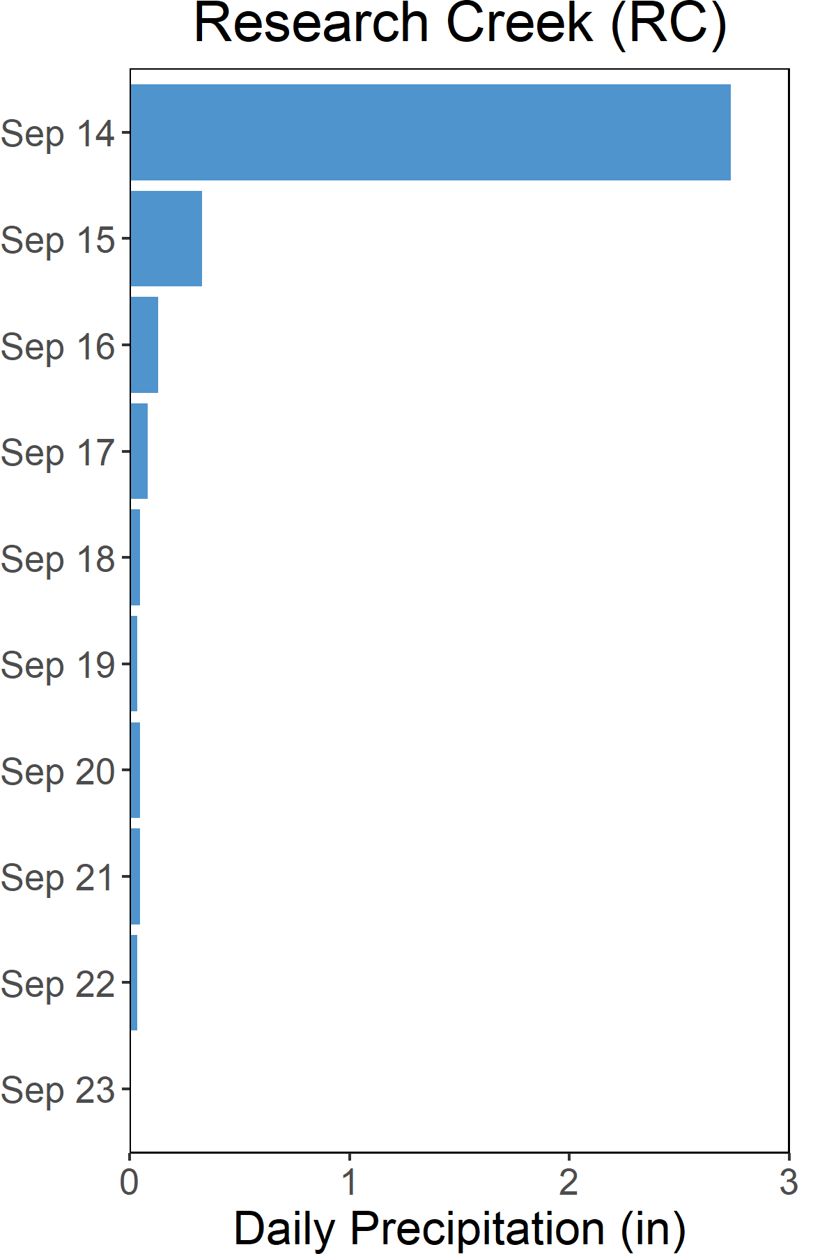
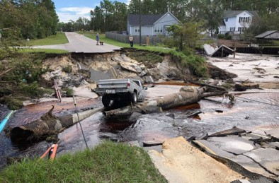

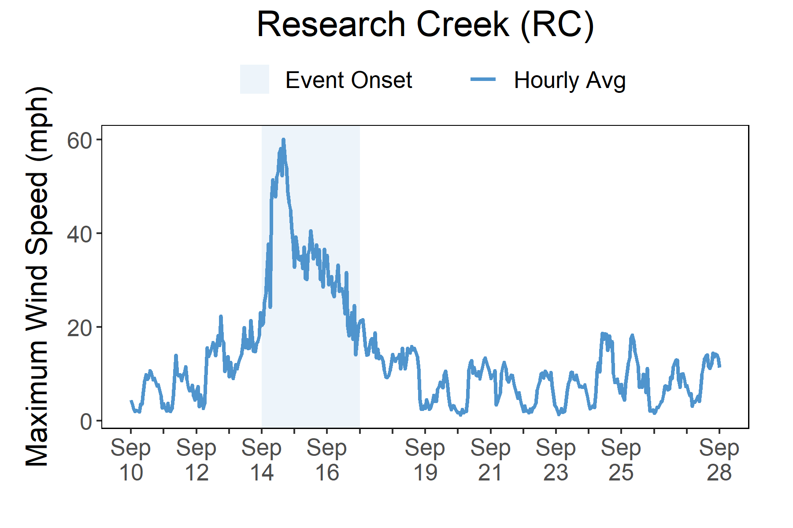

Rainfall
Florence brought heavy rains and freshwater flooding to North Carolina.
A total of 3.3 inches of rainfall fell in the reserve area over the course of six days as a result of the slow-moving and heavy rain-producing Hurricane Florence. Some areas in North Carolina experienced almost 3 feet of rainfall, which resulted in extreme and historic flooding.
Photos from the NC National Guard, taken in the areas of New Bern, Wilmington, and Lumberton on September 17, 2018.
In New Hanover County, widespread flash flooding on Sept. 14-15 closed many roads and inundated neighborhoods. The Cape Fear River flooded portions of downtown Wilmington with water over two feet deep, and at one point, the city of Wilmington was cut off entirely due to the floodwaters. Over 22 million gallons of untreated sewage overflowed into area waterways. Strong winds downed trees and power lines, cutting electricity to over 90 percent of the county. Many homes and businesses suffered wind damage to roofs, garage doors, and siding, and roads were blocked due to downed trees. In Carolina Beach and Kure Beach, significant beach erosion cut escarpments up to 10 feet high into the dune face. The southern end of Masonboro Island was overwashed, and 15 to 20 feet of dunes were lost on the north end of the island. An estimated 74,563 structures were flooded and 5,214 people were rescued from flooding in the state. Nearly 140,000 residents registered for disaster assistance after the storm. Damage losses in North Carolina due to Florence’s winds, freshwater flooding, and storm surge flooding totaled $22 billion.
Rainfall measurements at the Research Creek weather station from Sept. 14 through Sept. 23.
Wind Speed
Max wind speed recorded at the reserve was 66.2 mph on Sept. 14. High winds caused power outages and damaged structures.
Maximum Wind Speed readings at the Research Creek weather station from Sept. 10 through Sept. 28.

Slide 5
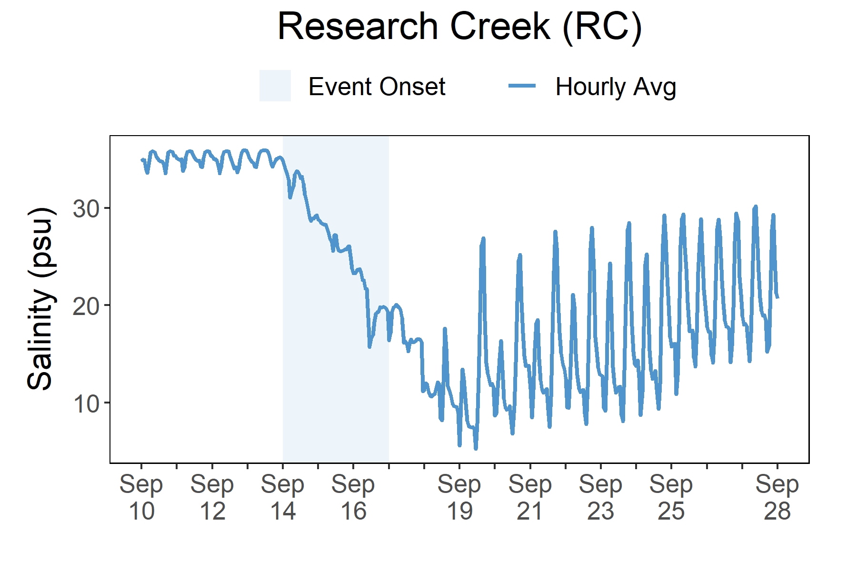
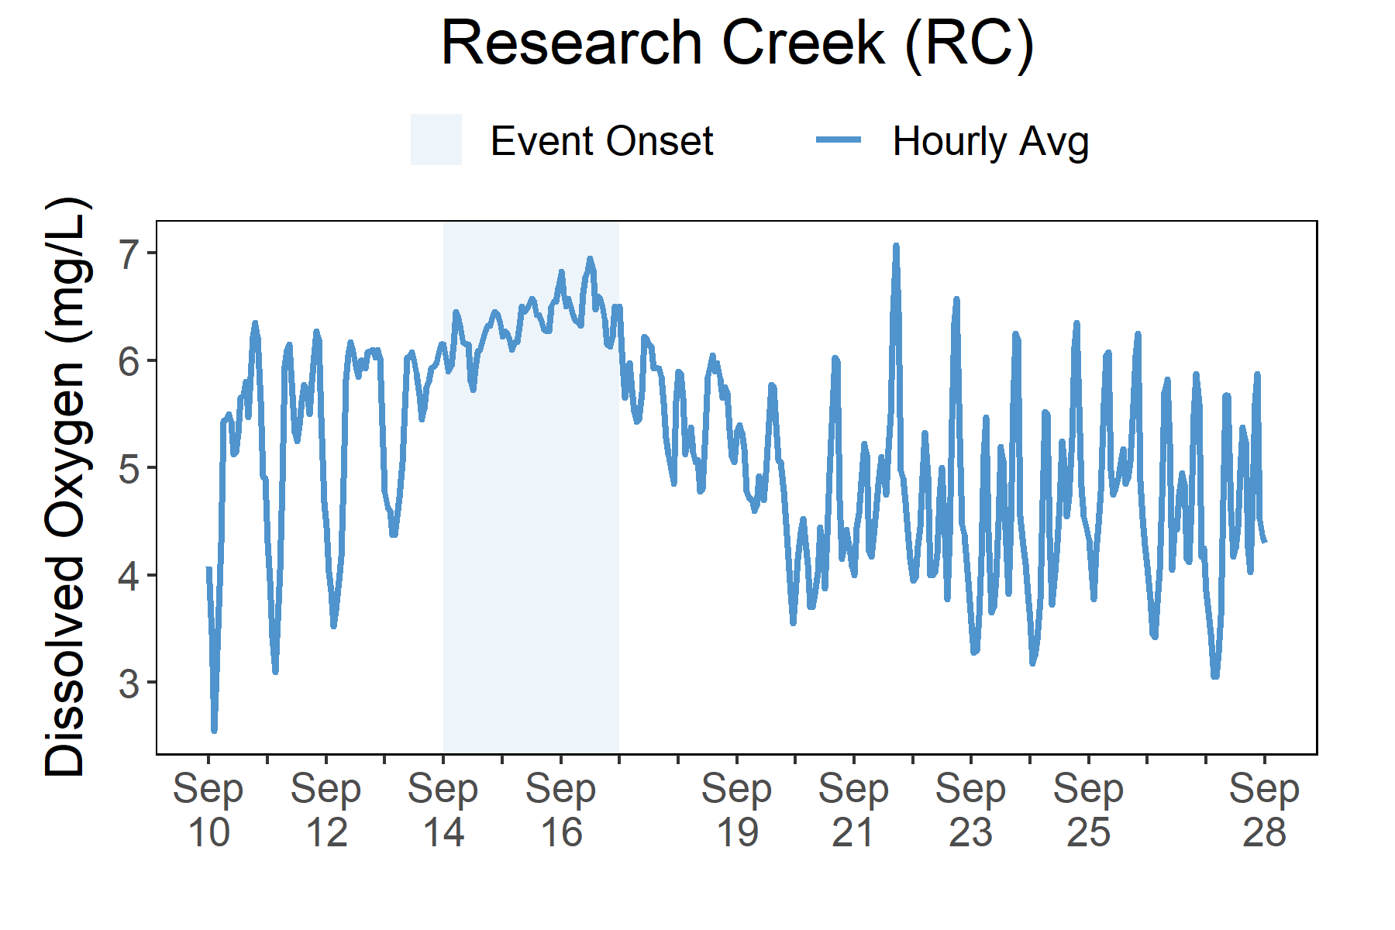
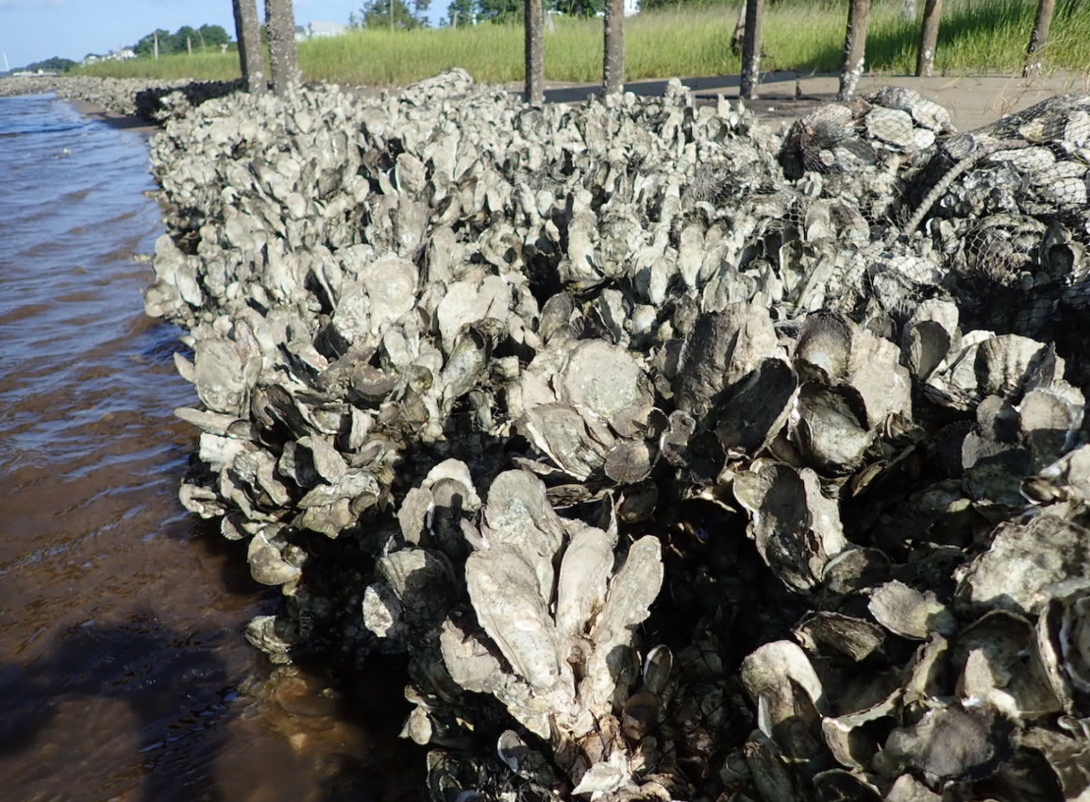
Salinity levels quickly dropped at Research Creek (RC) as Florence made landfall and then experienced large fluctuations as the extreme freshwater flooding followed for several days.
Station | Date | Depth Maximum (ft) | Salinity Minimum (psu) | Salinity Maximum (psu) | Dissolved Oxygen Minimum (mg/L) | Dissolved Oxygen Maximum (mg/L)
Research Creek | 9/14/2018 | 12.5 | 28.8 | 35.2 | 5.6 | 6.5
Research Creek | 9/15/2018 | 11.0 | 25.3 | 29.5 | 6.1 | 6.6
Research Creek | 9/16/2018 | 10.5 | 15.6 | 26.8 | 6.0 | 7.0
Research Creek | 9/17/2018 | 9.1 | 15.2 | 20.1 | 5.4 | 6.6
Research Creek | 9/18/2018 | 8.4 | 7.0 | 19.3 | 4.5 | 6.1
Data reporting time periods for Hurricane Florence: 9/14/2018 - 9/18/2018
Salinity
Dissolved Oxygen
Post-Storm Levels <5-30 psu
Pre-Storm Levels ~<3 – 6 mg/L
Post-Storm Levels ~>3 – 7 mg/L
Pre-Storm
Levels >30 psu
A big and fast drop in salinity occurred as Florence moved over the reserve
DO stayed at higher levels and did not vary much during the hurricane
Salinity levels from Sept. 10 to Sept. 28.
Dissolved Oxygen levels from Sept. 10 to Sept. 28.
Salinity and Dissolved Oxygen levels that were recorded at the Research Creek station show initial and post-storm impacts on water quality in this area. Salinity levels quickly dropped at the onset of the storm. As Florence moved out of the state, salinity levels experienced large fluctuations as the area experienced extreme flooding. Dissolved oxygen levels were impacted as well but the post-storm levels were actually higher than the pre-storm levels. Dramatic changes in salinity and lower levels of oxygen (<6 mg/L) can cause stress to some aquatic organisms depending on the species and how long the levels deviate from what is normal. Water quality stresses can impact survival and future populations.
Habitats in this reserve support about 90 percent of the commercial seafood species caught in North Carolina.

Slide 6
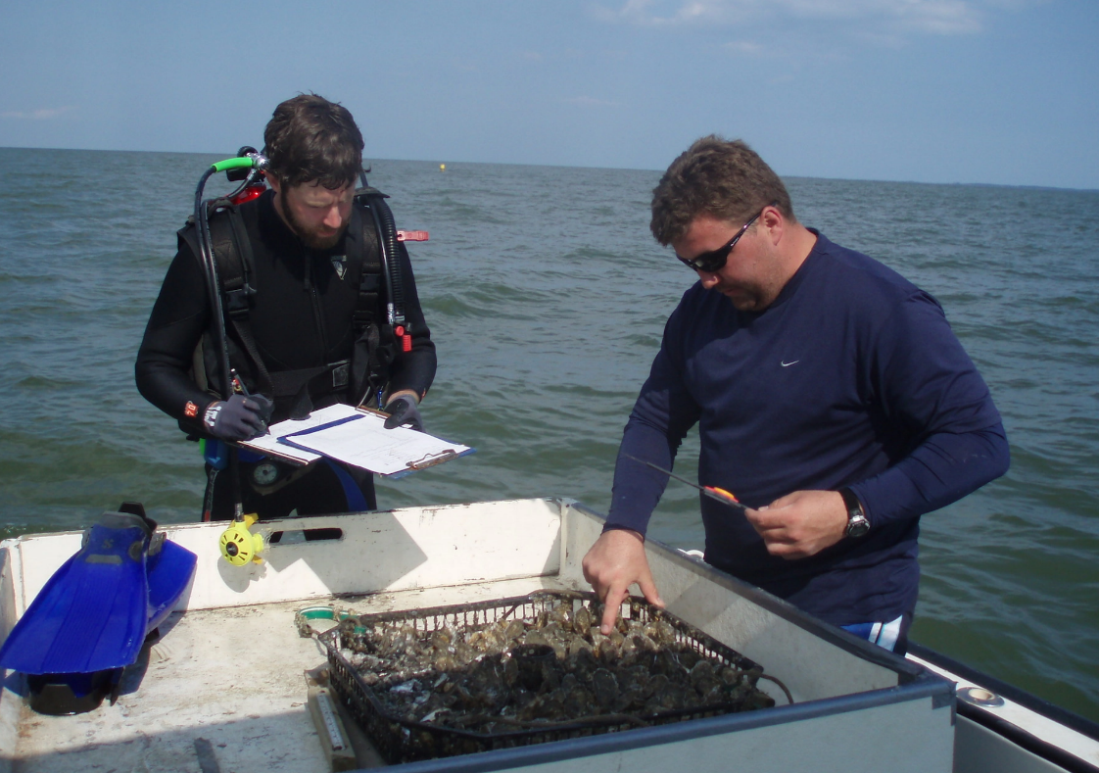
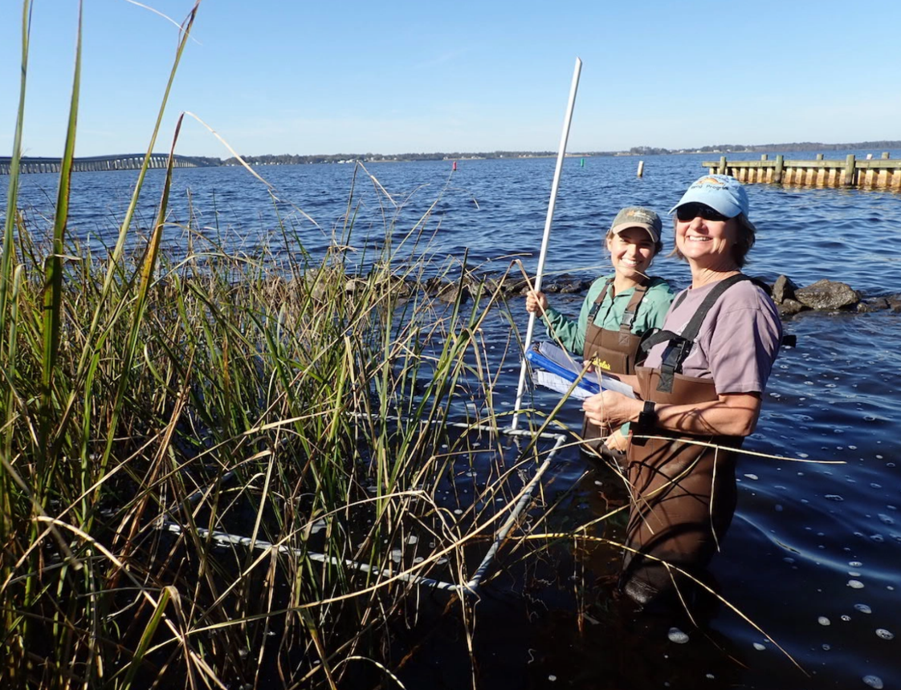

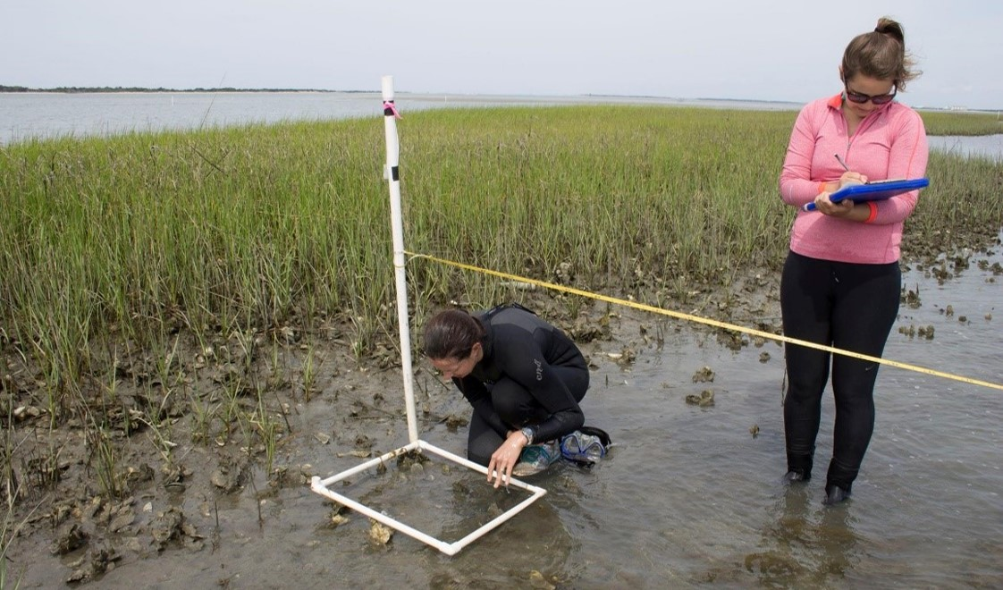
Brandon Puckett, Research Coordinator e: Brandon.Puckett@ncdenr.gov p: 252.838.0851
Visit www.nerrsdata.org to view and download weather and water quality data from North Carolina NERR.
Interested in learning more? Visit deq.nc.gov/coastalreserve. For video, news updates, online storm data and prediction visualization tools, check out our Storm Story Map at www.storm storymap.url.
@NCReserve

